Slide 1
READING YOUR RENT HISTORY
What is a rent history is,
how can I get one,
and what does it mean?

Slide 2
REASONS
Do you live in a rent stabilized apartment?
Knowledge is Power
Are you being overcharged?
Do you have a preferential rent?
Were MCIs and IAIs properly applied?
Current Circumstances
What is your current situation and how might new knowledge change it?
Deregulation Rent Threshold (DRT)
Financial incentive for landlords to reach this threshold and deregulate a rent-stabilized unit
Current DRT is $2,733.75.

Slide 3
SOURCES OF RENT INCREASE
Rent Guidelines Board increases
Current 2018-2019 Apartment and Loft Order #50
Vacancy increase
see Fact Sheet #5 for more information
MCIs and IAIs
Major Capital Improvement or Individual Apartment Improvement
Preferential Rent
MET Council on preferential rents
See Fact Sheet #40
History of rent increases

Slide 4
REQUESTING YOUR RENT HISTORY
Fill out the online contact form
Calling the rent info hotline at 718-739-6400
Visiting your borough or district office in person
Requesting your records via email: ORArecords@nyshcr.org

Slide 5
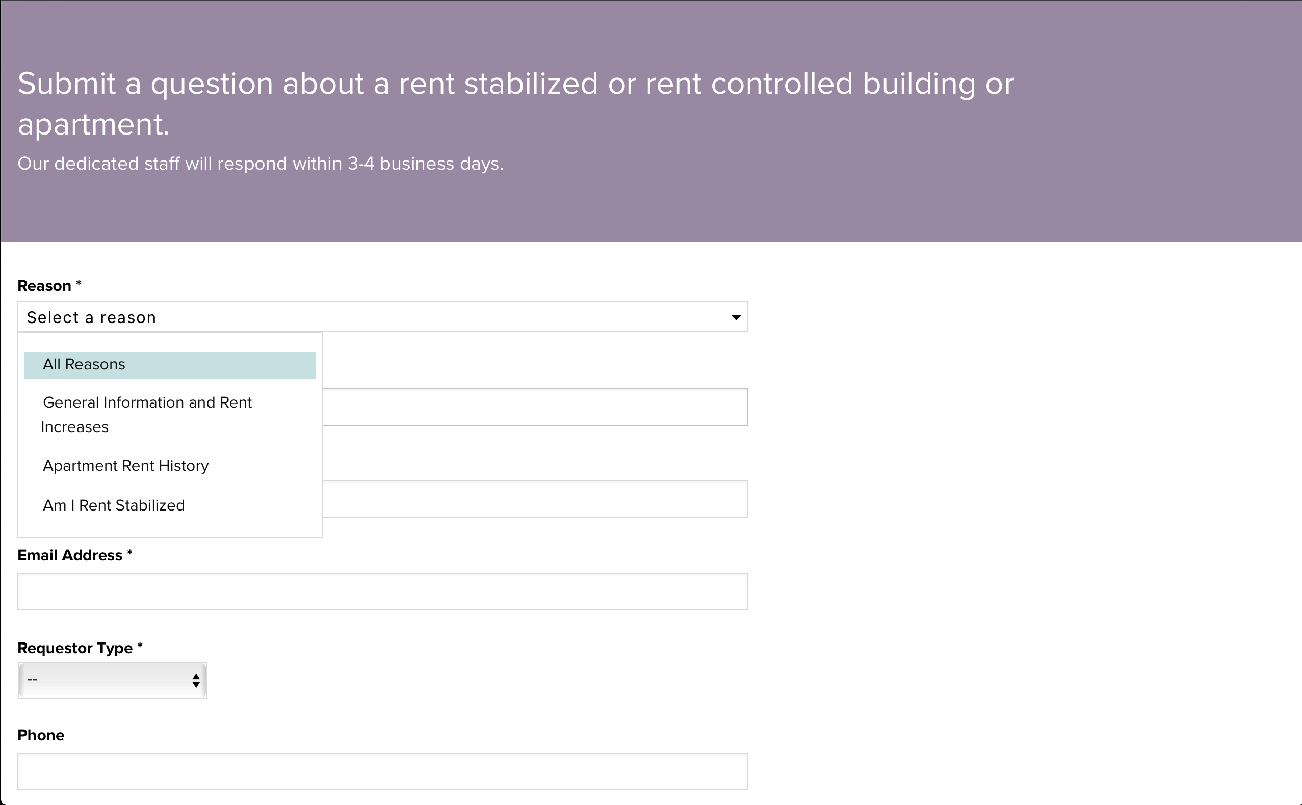
ONLINE CONTACT FORM

Slide 6
RENT HISTORY TERMS
RS = rent stabilized
V = vacant
PE = permanently exempt
RC = rent controlled
TE = totally exempt
W = paid weekly
NC = filing date was not recorded

Slide 7
RENT HISTORY TERMS
VAC/LEAS = vacancy lease
LEAS/RNL = lease renewal
IMPRVMNT = improvement
PREF RENT = preferential rent

Slide 8
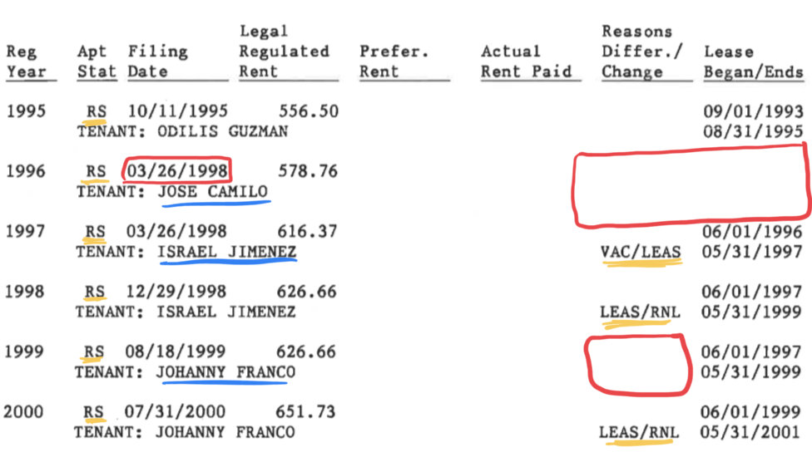
RENT HISTORY EXAMPLES

Slide 9
RENT HISTORY NOTES
(I) = initial year of registration for unit
(D) = indicates that year as the year the unit was vacancy decontrolled
(A) = indicates that an amendment to the annual apartment registration was filed by the owner

Slide 10
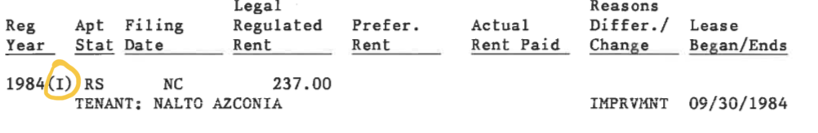
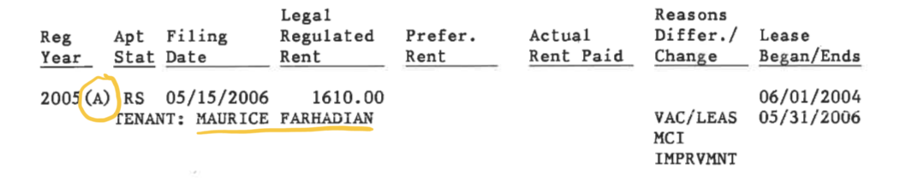
RENT HISTORY NOTES: EXAMPLES

Slide 11
RENT HISTORY EXAMPLE
Same year amendments: 2003-2005
Large rent increase from: 2004-2005
Owner occupancy and MCI: 2005
Change to preferential rent: 2007
Reset preferential rent: 2014
Current rent is above decontrol threshold: 2013-2016
However, the unit is still registered as rent-stabilized unit

Slide 12
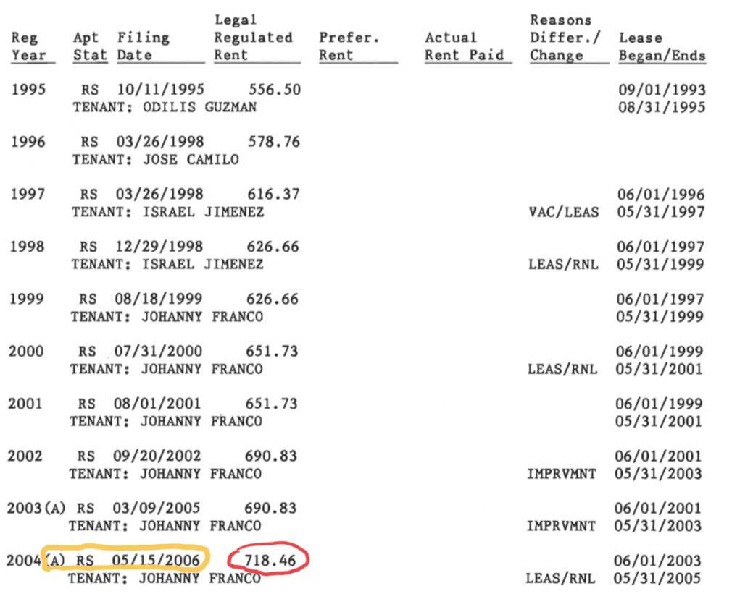

Slide 13
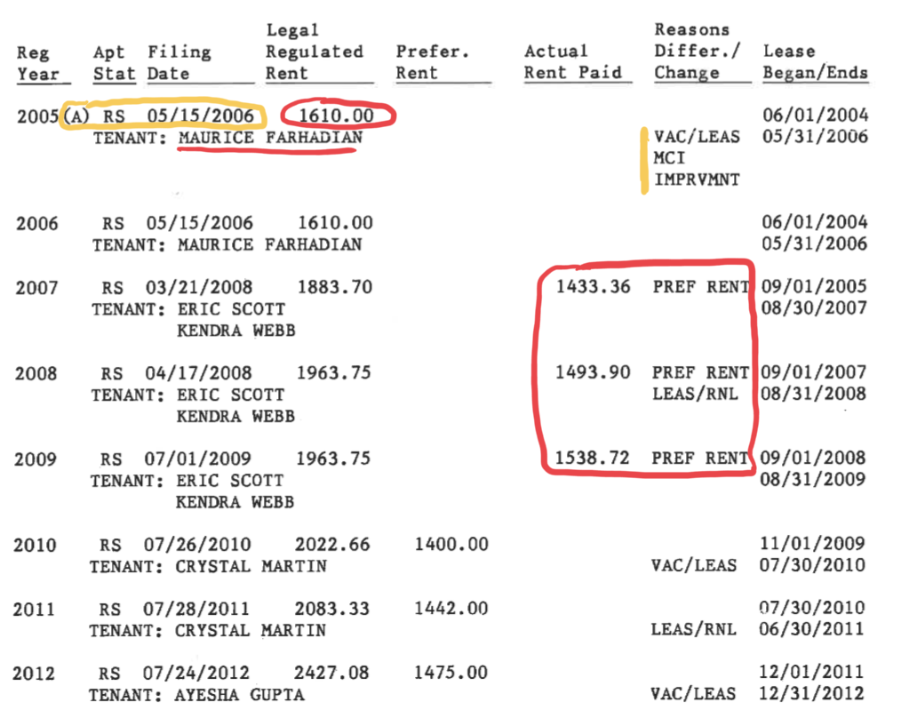

Slide 14
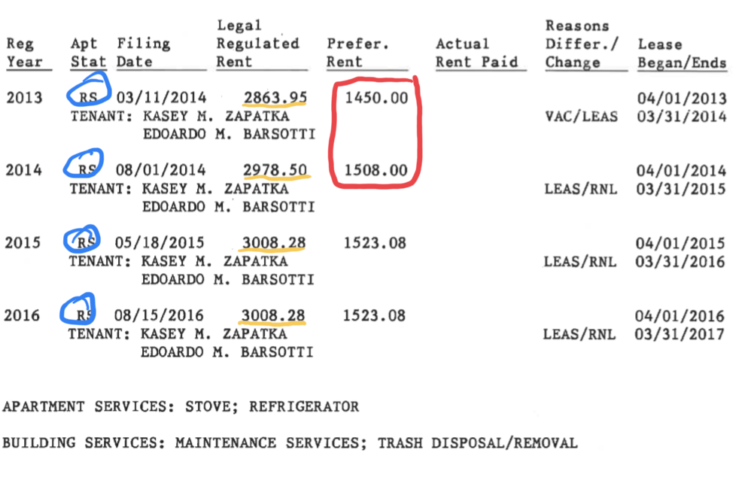

Slide 15
CONCLUSIONS
Currently live in a rent-stabilized apartment that is registered as having a legal rent regulate rent well above the threshold and a preferential rent
No disclosure of preferential rent on lease, so my preferential rent is my legal rent
Unit is subject to de-control because it is past the stature of limitations
Impact on next tenant

Slide 16
TAKEAWAYS
Important to know your rent history
There are many possible scenarios and it’s important to know where you actually stand
Collective solidarity and individual protection

Slide 17
RESOURCES
Accessing your Apartment’s Rent History
Rent-stabilized Building List
Fact Sheet #40: Preferential Rents
MET council on Preferential Rents

